Slide 2
Getting Started with Jenkins
Notes:
Trainer Notes: Introduce the lesson name

Slide 3

By the end of this lesson, you will be able to:
Explain the basics of Jenkins
Set up Jenkins in your machine
Configure Git with SSH keys
Explain Jenkins architecture
Establish Maven and JDK in Jenkins
Notes:
Trainer Notes: Introduce the topic to be covered

Slide 4
Setting Up Git

Slide 5
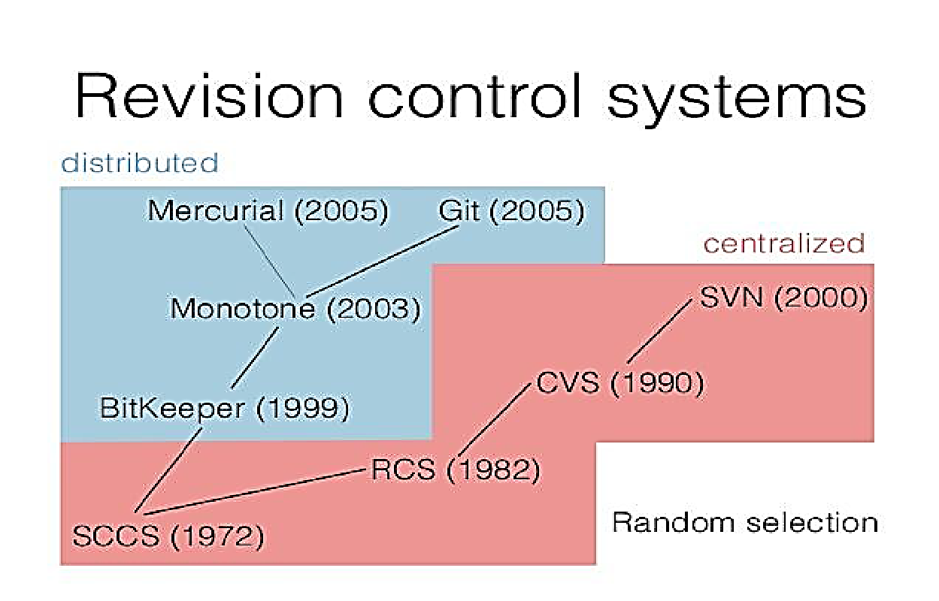
History of Version Control Systems
Version Control Systems (also known as revision control or source control) majorly focus on managing the changes to the files, programs, logs, and other information related to code development, code deployment, and code operation.
Notes:
Trainer Notes:
Explain all the points to the learner
The latest versions of all files ​ are often referred to as “heads.”

Slide 6

Need for Version Control Systems
Version control systems can be used to accomplish various tasks.
Files are checked into version
control by registered users only.
Supports branching where the
head of the repository is split for
parallel development.
The username and timestamp of the
check-in are associated with the revision.
Source control systems
are organized into repositories.
Each file check-in gets a new version
which is usually a number.
The latest versions of all files
are often referred to as “heads.”
All the previous versions of a file can
be easily extracted.
Notes:
Trainer Notes:
Explain all the points to the learner

Slide 7
Repository Usage
1
Files and folders which need to be changed over time.
Example: Constant addition of code for every increment in the feature.
3
Inappropriate use of a repository. Example: A photograph or music library.
2
Better tools for replicating data which doesn’t change. Example: Time machine for Apple computers.
Notes:
Trainer Notes:
Explain all the points to the learner

Slide 8
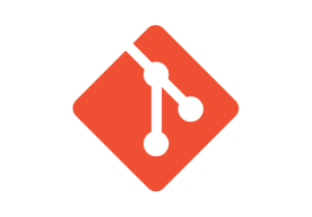




Popular Version Control Systems
Some of the most preferred and popular open-source version control systems and tools are listed in the image below:
Git
SVN
(Apache Subversion)
VCS
CVS
(Concurrent Versions Systems)
Bazaar
Mercurial
Notes:
Trainer Notes:
Explain all the points to the learner

Slide 9




Role of VCS in DevOps
Organize product-related artifacts
Adopt peer reviews to inspect changes
Provide tried and tested guaranteed results
Regulate monitoring of documents
Establish win-win relationship between Dev and Ops
Notes:
Trainer Notes:
Explain all the points to the learner

Slide 10
Types of VCS
It uses a single repository for each directory. It is often a symbolic link to a shared directory or network drive.
File System
Client-Server
It acts as a central repository which can be used by all. It supports Lock-Modify-Unlock and Copy-Modify-Merge.
Distributed
It creates replicas of the repository on each computer. It is fast and is based on immutable snapshots of its state.
Notes:
Trainer Notes:
Explain all the points to the learner

Slide 11
Git Terminologies
Bare repository, tag, and tree
Push and pull
Status, add, and rebase
Git Terminologies
Branch
Merge, master
Checkout
Head, hook, and index
Commit, commit object
Notes:
Trainer Notes:
Explain all the points to the learner

Slide 12
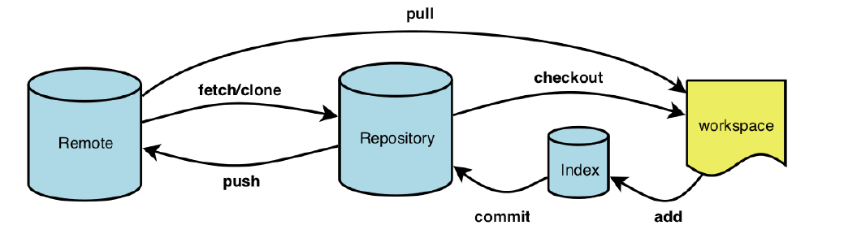
Git Workflow
1
3
5
git status
git push origin master
git init
git add <files>
git commit <files>
git rebase <parameters>
git checkout <references>
git merge <references>
2
4
Notes:
Trainer Notes:
Explain all the points to the learner

Slide 13
Git Installation
Git can be installed in both Linux and Windows platforms. Follow the below instructions to install Git to your system:
For Windows:
Download Git from the below website and run the executable file in your machine and Git will be installed to your system.
https://git-scm.com/download/win
For Linux (Ubuntu or Debian):
Run the command given below in the terminal to install Git to your system.
sudo spt-get install git
For Fedora (any other RPM-based distributed system):
Run the command given below in the terminal to install Git to your system
sudo yum install git-core
Notes:
Trainer Notes:
Explain all the points to the learner

Slide 14
Git Setup
Problem Statement: You are given a project to push files from the local Git folder to the GitHub repository.
Steps to perform:
Create an account in GitHub and create a repository.
Initialize the Git repo locally.
Create files with every extension, and add random content in it (.txt, .html, .java ).
Sign in to the GitHub account.
Generate SSH key for local Git repository.
Connect the local and remote repository using SSH key.
Add the codes to the repositories of GitHub.
Notes:
Trainer Notes:
Explain the objective

Slide 15
Setting Up Jenkins

Slide 16

What Is Jenkins?
Definition by Jenkins.io: Jenkins is a self-contained, open-source automation server which can be used to automate all sorts of tasks related to building, testing, and delivering or deploying software.
One can install Jenkins as a standalone software, Docker, and also as a package on the machine that has JRE pre-installed.
Prerequisites:
A machine with 256 MB of RAM, although more than 512MB is recommended.
10 GB of drive space (for Jenkins and your Docker image)
The following software installed:
Java 8 (either a JRE or Java Development Kit (JDK) is fine)
Docker suitable for your system.
Notes:
Trainer Notes:
Explain all the points to the learner

Slide 17
Features of Jenkins
Easy to configure, modify, and extend
Platform independent
7
1
Open-source
and user-friendly
Rich plugin ecosystem
6
2
Immediate detection and resolution of issues
5
3
Support from large
communities
4
Scaling of large error-ridden integrations
Notes:
Trainer Notes:Give an overview of Test Driven Development
Explain the process of TDD

Slide 18
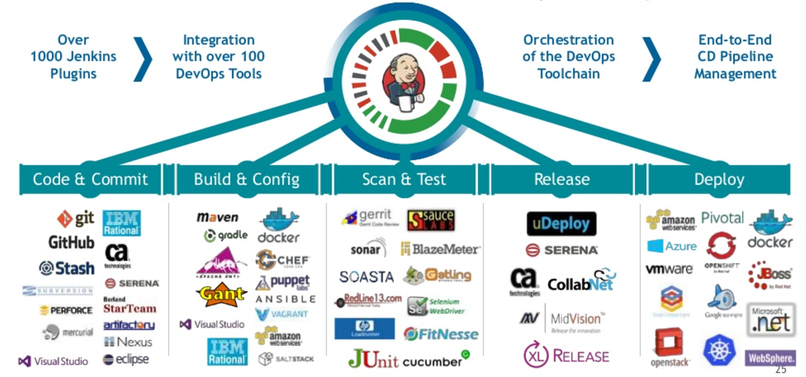
CI with Jenkins

Slide 19
Jenkins Installation
Jenkins can be installed in both Linux and Windows platforms. Follow the below instructions to install Jenkins to your system:
For Windows:
Download Jenkins from the below website and run the executable file in your machine and Jenkins will be installed to your system.
https://jenkins.io/download/thank-you-downloading-windows-installer-stable/
For Linux (Ubuntu or Debian):
Run the command given below in the terminal to install Jenkins to your system.
sudo apt-get install jenkins
For Fedora( any other RPM-based distributed system):
Run the command given below in the terminal to install Jenkins in your system
sudo yum install jenkins
Notes:
Trainer Notes:
Explain all the points to the learner

Slide 20
Building A Build Server
Installing Jenkins on your local development machine is one thing, but installing Jenkins on a proper build server deserves a little more forethought and planning. Below are the points to be considered while preparing a reliable build server:
Master-slave architecture
Memory and processor-intensive operations
7
1
Use a virtual machine
2
Number of build jobs
6
Type and complexity of application
5
3
CPU horsepower
4
One processor per parallel build
Notes:
Trainer Notes:
Explain all the points to the learner

Slide 21
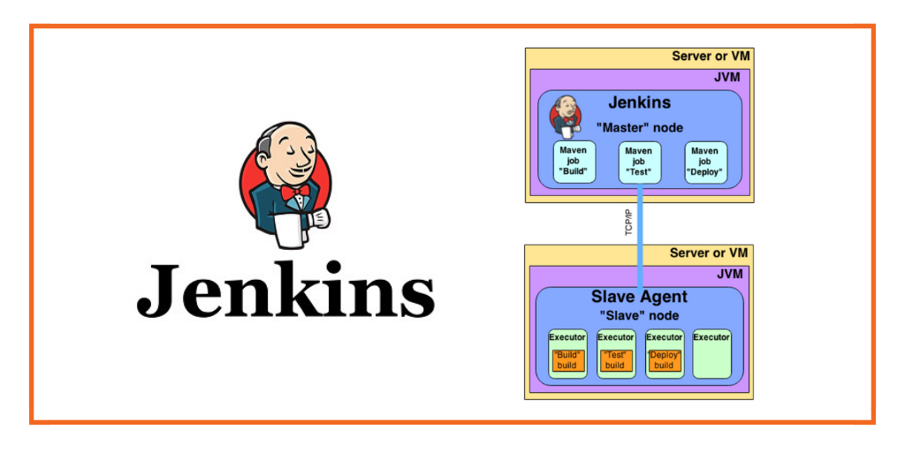
Building A Build Server
If you are installing Jenkins on a Linux or Unix build server, it is a good idea to create a special user (and user group) for Jenkins.
This makes it easier to monitor the system resources being used by the Jenkins builds, and to troubleshoot problematic builds in real conditions.
The native binary installation packages, discussed below, do this for you. If you did not use one of these, you can create a dedicated Jenkins user.
Run the following command as shown below or you can use Jenkins UI to do the same:
$ sudo groupadd build
$ sudo useradd --create-home --shell /bin/bash --groups build jenkins
Notes:
Trainer Notes:
Explain all the points to the learner

Slide 22
Jenkins Setup
Problem Statement: You are given a project to set up and run Jenkins on your system.
Steps to perform:
Download the Java Runtime Environment
Download and installing the Jenkins app
Notes:
Trainer Notes:
Explain the objective

Slide 23
Configuring Dev Tools

Slide 24
Maven Configuration
Maven is a high-level build scripting framework for Java that uses notions such as a standard directory structure and standard life cycles, Convention over Configuration, and Declarative Dependency Management to simplify a lot of the low-level scripting that you find in a typical Ant build script.
In Maven, your project uses a standard, well defined build life cycle—compile, test, package, deploy, and so forth.
Each life cycle phase is associated with a Maven plugin.
Maven
Jenkins provides excellent support for Maven, and has a good understanding of Maven project structures and dependencies
The various Maven plugins use the standard directory structure to carry out these tasks with a minimum of intervention on your part.
Notes:
Trainer Notes:
Summarize the points

Slide 25
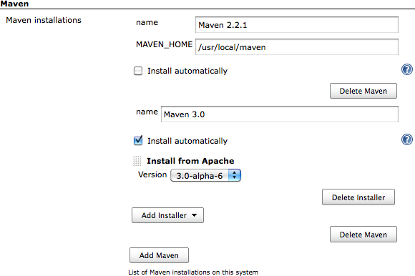
Maven Configuration
You can either get Jenkins to install a specific version of Maven automatically or provide a path to a local Maven installation
Notes:
Trainer Notes:
Summarize the points

Slide 26
Ant Configuration
Ant is a widely-used and very well-known build scripting language for Java. It is a flexible, extensible, relatively low-level scripting language, used in a large number of open source projects.
For example, you need to compile your code before you can run your unit tests.
An Ant build script (typically build.xml) is made up of a number of targets, which perform different tasks in build process.
Ant
Targets also have dependencies, indicating the order in which your build tasks need to be executed.
It does so by executing tasks, which carry out a specific part of the build job, such as invoking javac to compile your code, or creating a new directory.
Notes:
Trainer Notes:
Summarize the points

Slide 27
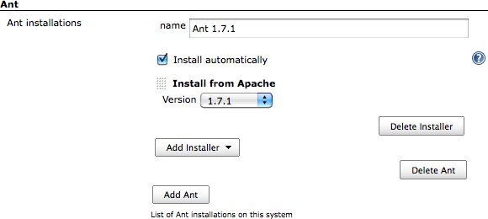
Ant Configuration
Jenkins provides excellent build-in support for Ant. If Ant is available on the system path, Jenkins will find it. However, you can configure as many installations of Ant as required by providing name and installation directory of the versions.
Notes:
Trainer Notes:
Summarize the points

Slide 28
Maven Set Up
Problem Statement: You are given a project to set up Maven with Jenkins.
Steps to perform:
Configure the Maven
Configure the JDK
Notes:
Trainer Notes:
Explain the objective

Slide 29
Exploring Jenkins

Slide 30
Jenkins Architecture
Jenkins follows the Master-Slave architecture to manage builds. Slave and master communicate through a TCP/IP connection.
Notes:
Trainer Notes:
Explain all the points to the learner

Slide 31
Jenkins Master and Slave Architecture
Jenkins Master
By default, it runs on the 8080 port.
With the help of dashboard, jobs can be configured
The build is executed in the slave.
Can add more nodes using IP address, username and password using the ssh, jnlp or webstart methods.
The master's job is to:
Scheduling build jobs
Dispatching builds to the slaves
Monitoring the slaves
Recording and displaying the build results
Jenkins Slave
Jenkins slave is used to execute the build jobs.
Build jobs are distributed by the master node.
You can configure a project to always run on a particular slave machine.
By default, Jenkins automatically selects the available slave node for executing builds.
As Jenkins is developed using Java, it is platform independent and can be configured in Linux, Windows, and Mac.
Jenkins Master/Slave Architecture
Notes:
Trainer Notes:
Explain all the points to the learner

Slide 32
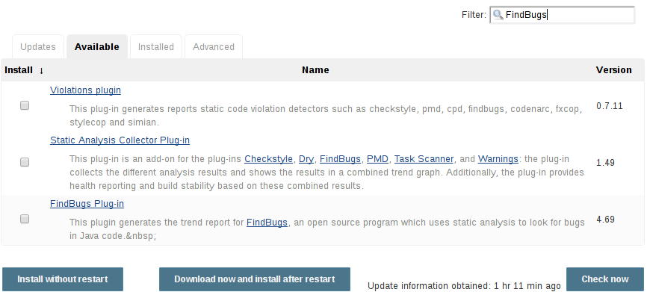
Plugins
Plugins are used to enhance the functionality of a Jenkins environment to complement and support the needs that are organization, or user-specific.
The different ways to install plugins are:
Using the Plugin Manager in the web UI ( the screenshot is given below)
Using the Jenkins CLI install-plugin command
Notes:
Trainer Notes:
Explain all the points to the learner
Plugins are the primary means of enhancing the functionality of a Jenkins environment to suit organization- or user-specific needs. There are over a thousand different plugins which can be installed on a Jenkins master and to integrate various build tools, cloud providers, analysis tools, and much more.

Slide 33
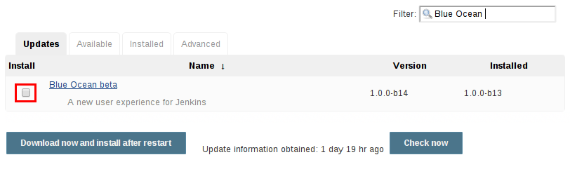
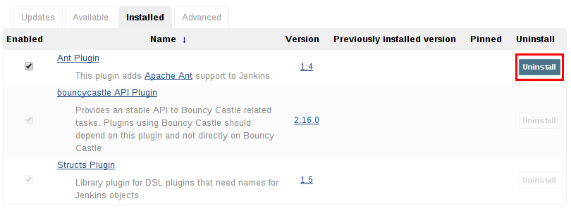
Plugin Operations
Update and delete are the two operations that can be performed on a plugin.
The screenshots of updating and deleting a plugin from the Plugin Manager are given below:
Notes:
Trainer Notes:
Explain all the points to the learner

Slide 34

Notifications
The importance of setting up notifications in Jenkins include:
When a Jenkins build breaks, the entire team is notified via email messages
Using plugins, you can also send instant SMS messages, or post entries on Twitter.
Easy set up.
If the local SMTP server address is present, you can just provide its value in the email notification section
Notes:
Trainer Notes:
Explain all the points to the learner

Slide 35
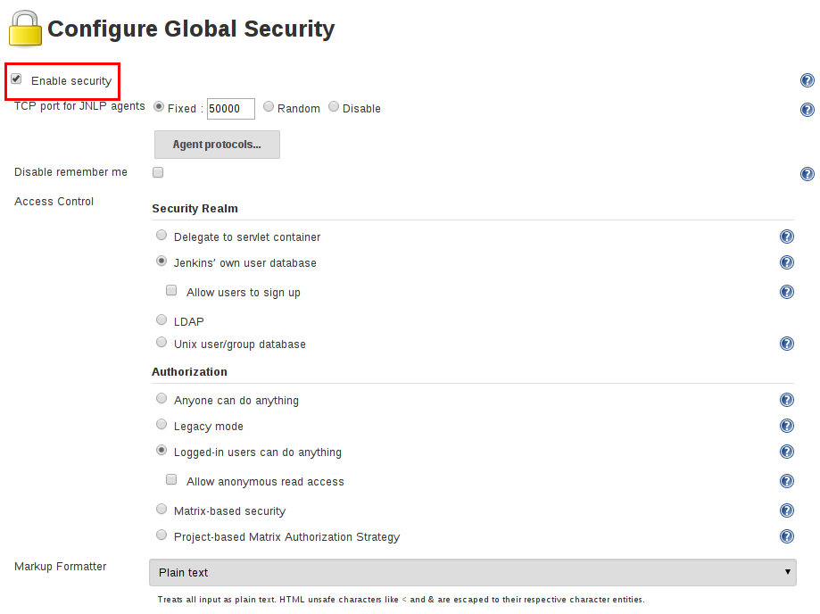
Security
As Jenkins is used in many organization, Jenkins offers many configuration options for enabling, editing, or disabling various security features.
Enable security section allows a Jenkins administrator to enable, configure, or disable security features.
Access control is the primary security mechanism for a Jenkins environment and have two major parameters:
Security Realm which informs the Jenkins environment about the user authentication.
Authorization configuration states the users and/or groups that have the permission to access Jenkins.
Notes:
Trainer Notes:
Explain all the points to the learner

Slide 36
Blue Ocean Strategy
Blue Ocean is an approach strategy and user experience enhancement in Jenkins that goes on-par with pipeline, which in itself is an optimized build strategy.
Sophisticated visualizations of Continuous Delivery (CD) pipelines for monitoring its status.
Pipeline editor enables creation of pipelines through visual process (UI).
Features of BlueOcean
Personalization allows to fulfill the needs of each member of the team.
Pinpoint precision indicates where the attention is required in the pipeline to facilitate exception handling.
Native integration for branch and pull requests enables maximum developer productivity when collaborating with GitHub and Bitbucket.
Notes:
Trainer Notes:
Explain all the points to the learner

Slide 37
Blue Ocean Installation
Blue Ocean can be installed both on the existing Jenkins instance and as a part of Jenkins Docker.
Existing Jenkins instance
Jenkins Docker
To install the Blue Ocean suite of plugins on an existing Jenkins instance, your Jenkins instance must be running Jenkins 2.7.x or later.
Plugins can be installed by any Jenkins user who has the Administrator access.
You can install Blue Ocean plugin from Manage Plugin page.
Image has a tag for every release of blue ocean.
To run the latest configurations, ensure to run docker pull jenkinsci/blueocean.
To run Jenkins docker, use the command
docker run -p 8080:8080 jenkinsci/blueocean
Browse http://localhost:8080/blue to open the dashboard.
Notes:
Trainer Notes:
Explain all the points to the learner

Slide 38
Build a Maven Project
Problem Statement: You are given a project to set up and run a Maven job in Jenkins.
Steps to perform:
Configure git on Jenkins.
Fork a sample repository.
Add the Maven plugin to Jenkins
Create a Jenkins build job of Maven type.
Build the Maven project.
Notes:
Trainer Notes:
Explain the objective

Slide 39
Jenkins is a middleware for the development cycle that connects different tools with one another and helps is smooth data flow.
Git is one of the most popular tools for version control that helps in organizing code and executing testing operations.
Jenkins provides more than thousand plugins to cover all the requirements of a CI/CD pipeline.

Slide 41
Which command is used to install GIT in an RPM-based distributed system?
1
sudo apt-get install git
sudo yum install git-core
Both
None of the above

Slide 42
Which command is used to install GIT in an RPM-based distributed system?
1
sudo apt-get install git
sudo yum install git-core
Both
None of the above
B
sudo yum install git-core is used in Fedora and other RPM-based distributed systems.

Slide 43
How to convert a folder into a Git repository?
2
Run git init
Run git initialise
Both
None of the above

Slide 44
How to convert a folder into a Git repository?
2
Run git init
Run git initialise
Both
None of the above
A
git init is the command to convert any folder into a Git repository.

Slide 45
Which of the following is NOT a feature of Jenkins?
3
Platform independent
Open-source
Scaling of large error-ridden integrations
None of the above

Slide 46
Which of the following is NOT a feature of Jenkins?
3
Platform independent
Open-source
Scaling of large error-ridden integrations
None of the above
D
All of the above mentioned features can be implemented in Jenkins.

Slide 47
How is Maven project added in Jenkins?
4
By adding the project folder in Jenkins storage
By adding the location of pom.xml in Maven settings
Both
None of the above

Slide 48
How is Maven project added in Jenkins?
4
By adding the project folder in Jenkins storage
By adding the location of pom.xml in Maven settings
Both
None of the above
B
Jenkins is capable of building the entire application with the help of pom.xml.

Slide 49
What is Jenkins?
5
Version control system
Middleware between development and production environment
Monitoring tool
Configuration management tool

Slide 50
What is Jenkins?
5
Version control system
Middleware between development and production environment
Monitoring tool
Configuration management tool
B
Jenkins is majorly used to integrate various tools and softwares included in SDLC to work in-sync for better flow of development.

Slide 51
Building a Maven Project with Jenkins
Problem Statement:
You’re a DevOps engineer at PlanMyTrip, which is a web and mobile based app company that helps users plan their itineraries based on distance, climate, availability of transport, and accommodation. The company wants to use the OpenWeatherMap API for weather predictions. You’re required to write a microservice that checks if the API is up and set up a Jenkins build job to compile and package the app with Jenkins. The program and the build job is expected to be expanded in the future to add additional functionalities like redirection, notification, etc. You’re expected to create the program and build job to scale.
Requirements:
The program should be built with Maven
The build job should be designed to build a local repository
The build job should compile and run the code if the build succeeds
Notes:
Trainer Notes: Explain the project to the learners, and instruct them to perform it after the lesson.

